Slide 1

Tips for successful PowerPoint

Slide 2
Tips…
When starting a new presentation, always save and name it before you even begin typing.
  File – Save As
  Always update your save with “control s”.
Create your presentation in ALL BLACK AND WHITE first.
  Don’t waste your time playing around with colors, fonts or designs until all of your data is typed in.
    Or you will never get your slide show created.
  Make it “pretty” once the work is done.

Slide 3
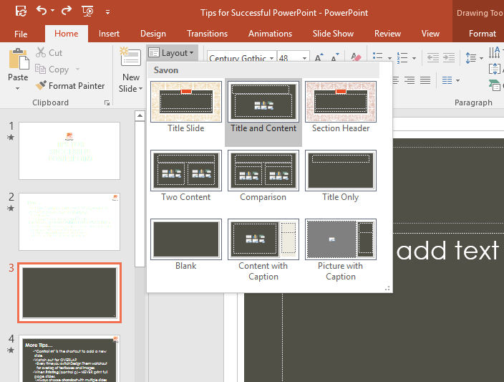
Inserting a Slide
Home Tab
  New Slide
  Choices
Most Popular Styles
  Title Slide
  Title and Content
  Two Content

Slide 4
Using bullets
Each time you strike the tab key the information
      You are typing will indent to the right
      The more you tab, the more it will indent
  If you want your information to move left
      Move back toward the left margin
      Strike “shift tab.”
Holding down SHIFT and TAB together will move your tab left, back out to the left margin.

Slide 5
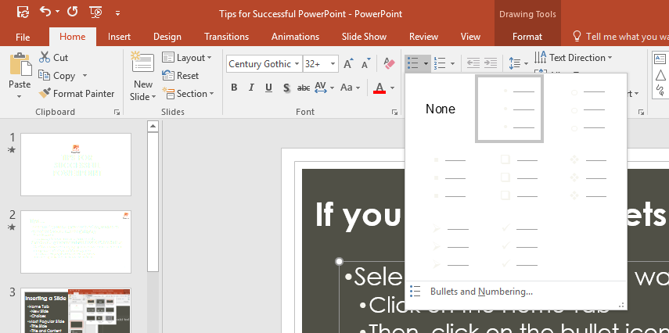
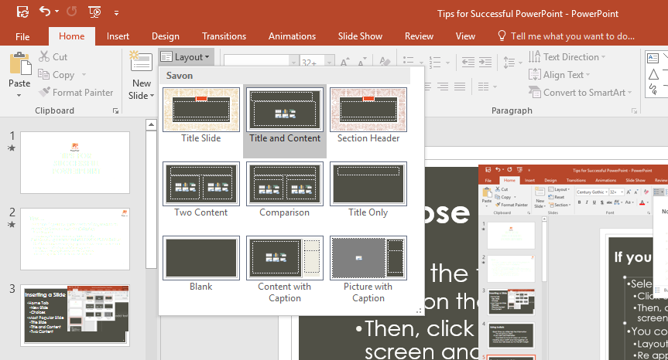
Lose your bullets?
Select the text box you want bullets in
  Click on the Home Tab
  Then, click on the bullet icon at the top of the screen and try to reapply your bullets.
You could also go back up Home Tab
  Layout
  Re apply the slide layout

Slide 6
More Tips…
“Control m” is the shortcut to add a new slide.
Watch out for OVERLAP
  Every time you switch Design Them watch out for overlap of textboxes and images.
When Printing (control p) – NEVER print full page slides.
  Always choose a handout with multiple slides per sheet of paper.

Slide 7
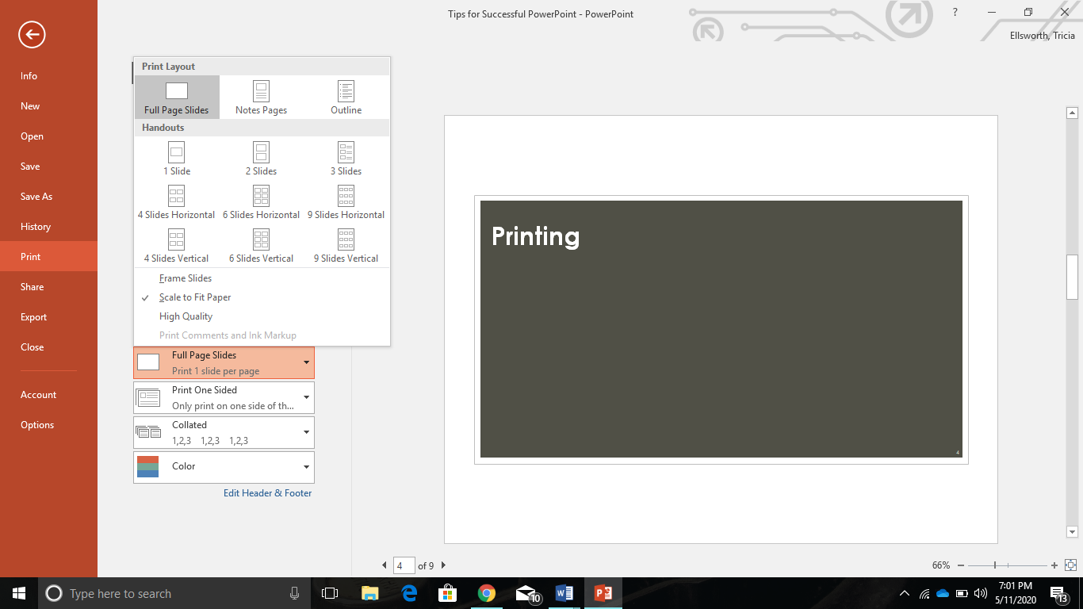
Print Using Handouts
File
  Print
    Slides
      Choose Handouts
        Ex. 6 slides per page
NEVER Print FULL PAGE Slides
  It is a huge waste of ink & paper

Slide 8
Font Tips
Make sure your font is at least size 20.
  Visibility is key.
Utilize your bullets.
  Don’t type a book on a slide.
  Use brief points.
  Try for no more than 6 points per slide.
Remember to tab in and tab out.
    “Shift tab” will move your tab back out.

Slide 9
Graphics and Design Tips
Use Designs and Images that fit with the topic of your presentation.
Do not over use
  Animation
  Sound
  Color

Slide 10
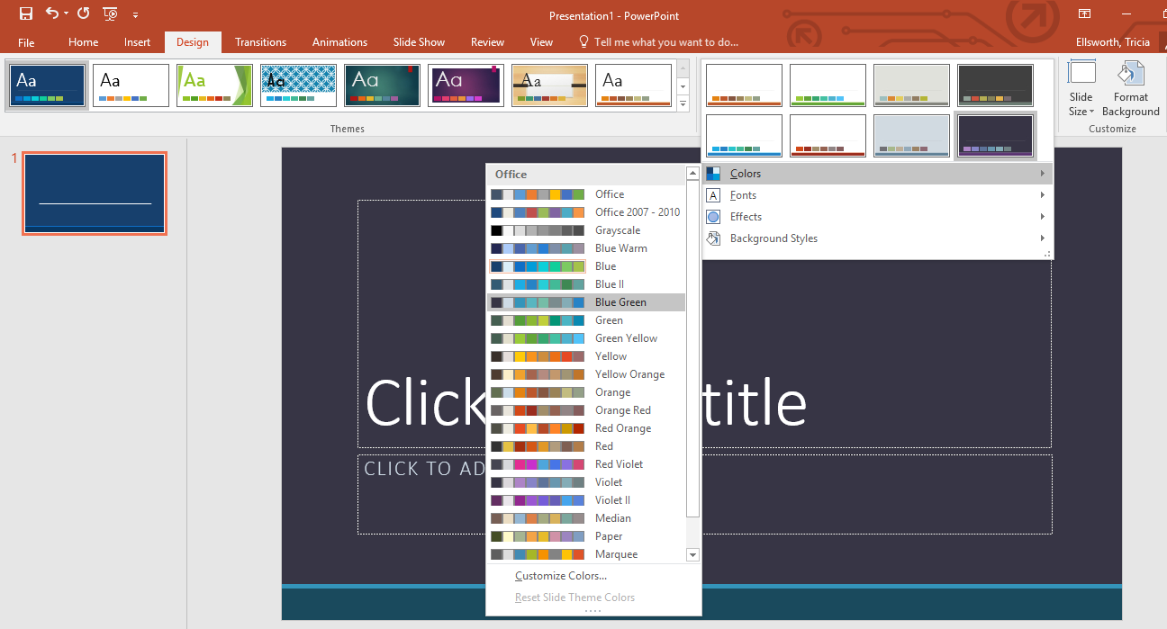
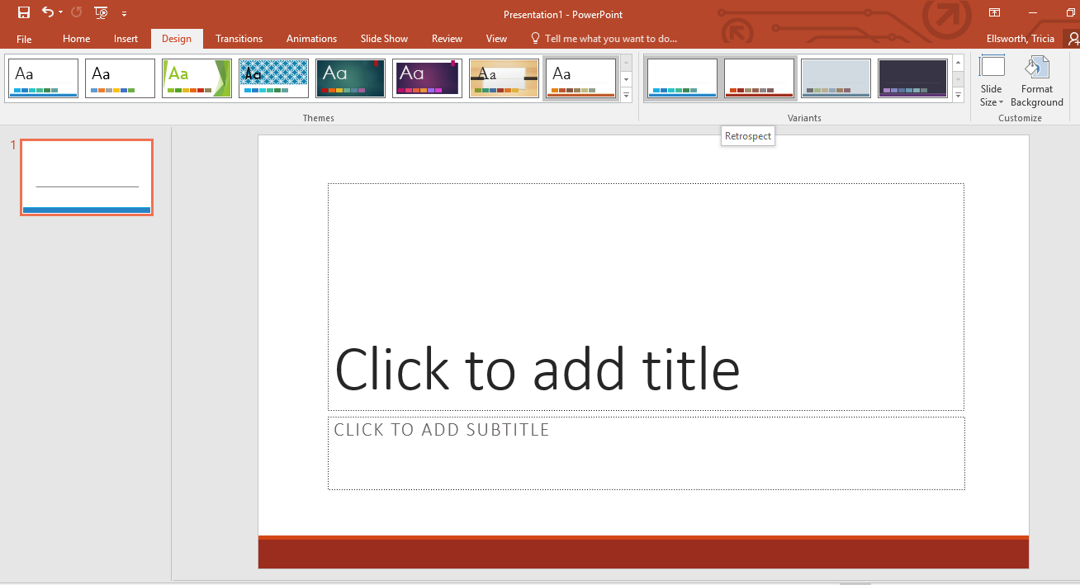
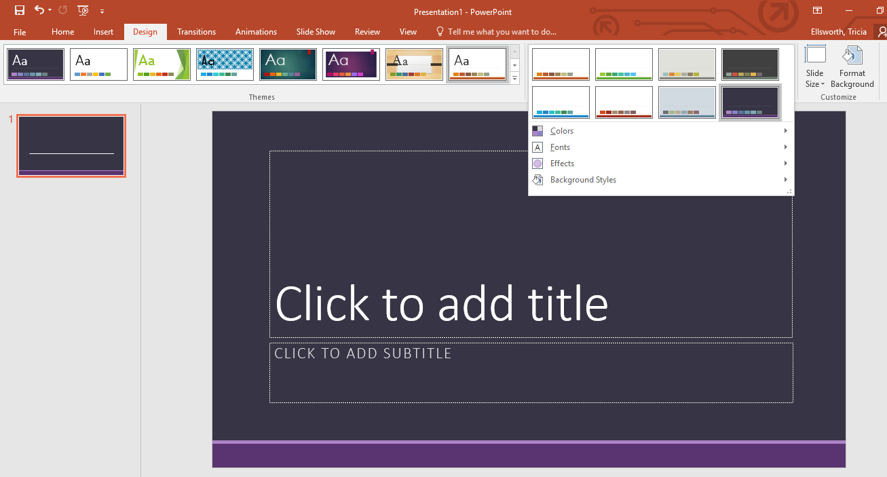
Design Tab
- Variants

Slide 11
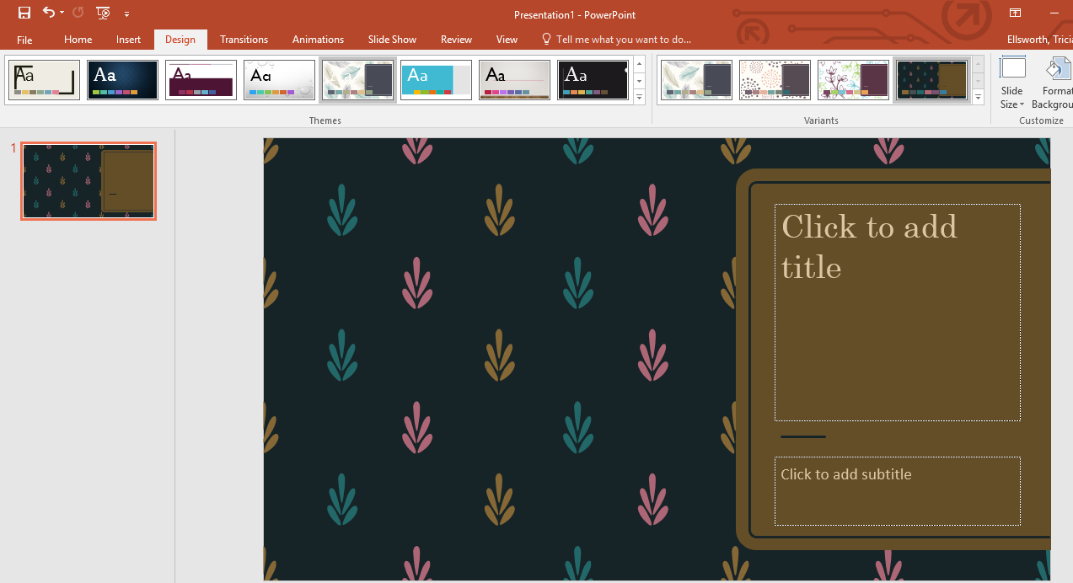
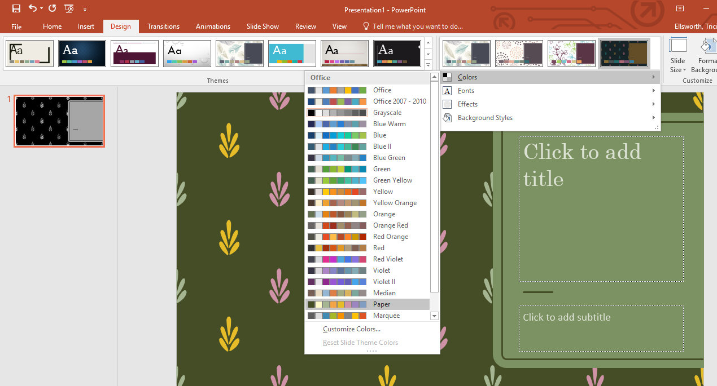
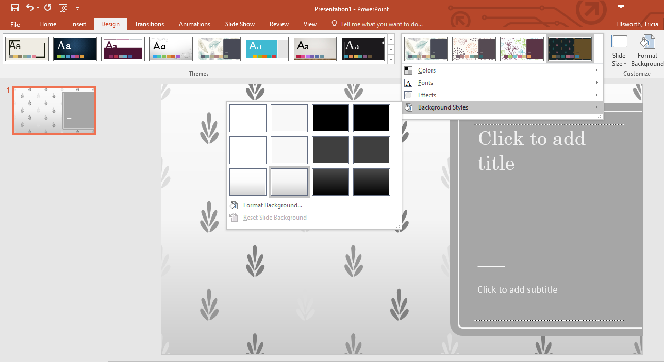
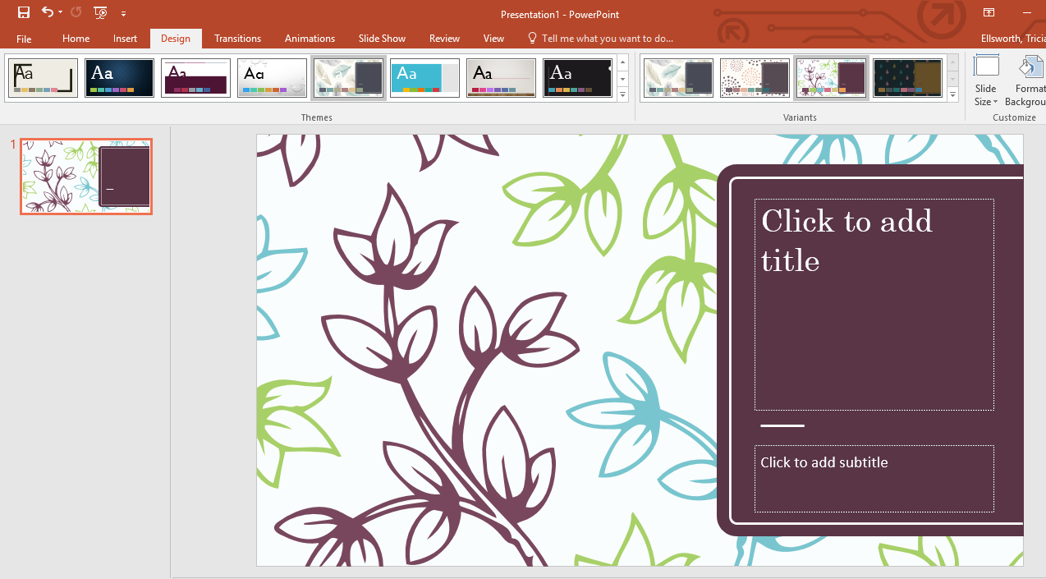
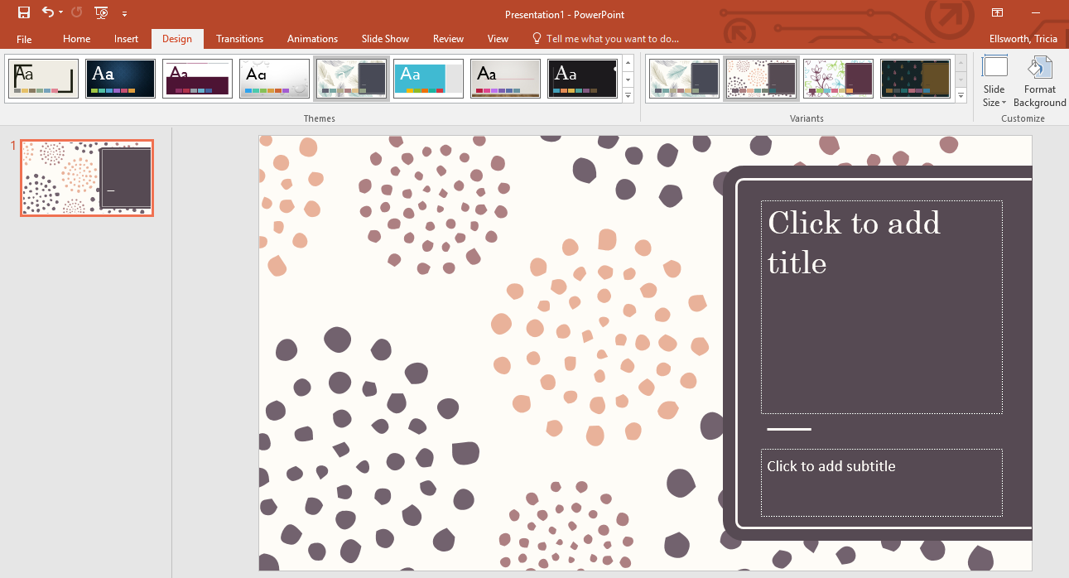
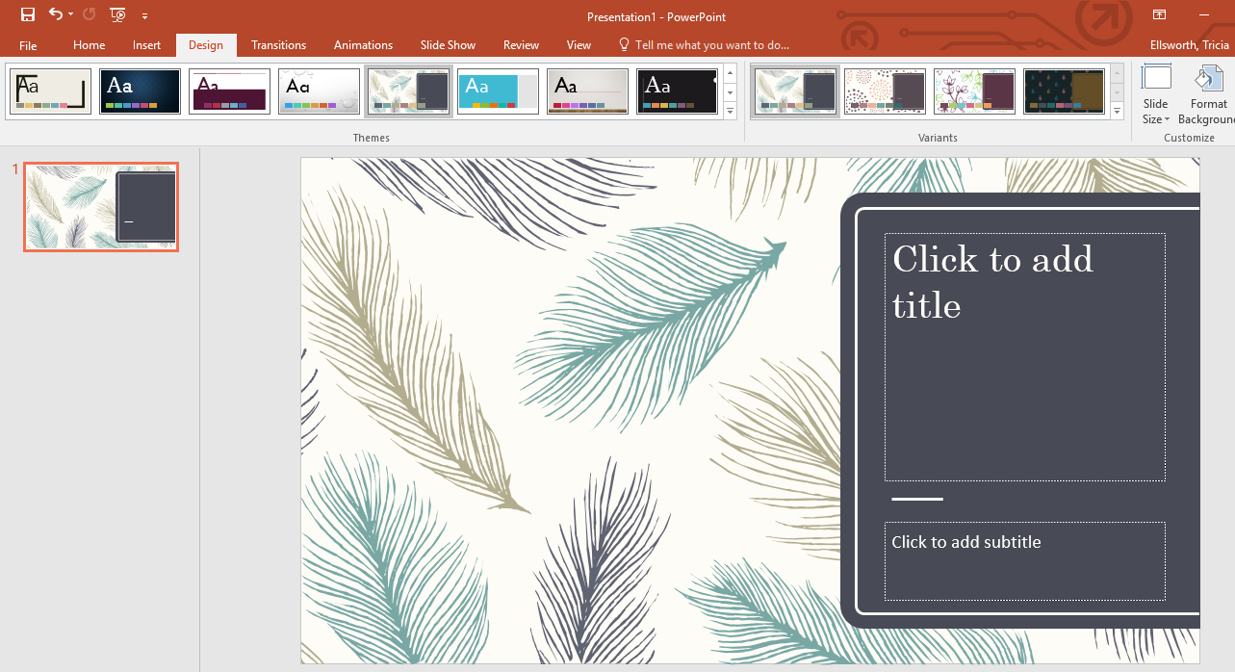
More on Variants

Slide 12
Color Tips
Choose a color scheme that is easy on the eyes.
  Use dark text on light backgrounds.
  Use light text on dark backgrounds.
  Using images as backgrounds can make your font difficult to read.
Make sure your colors look professional, not obnoxious.

Slide 13
Presentation Tips
Ask someone else to proofread your presentation prior to presenting.
Use animations to make your bullet points appear separately.
  This allows the audience to focus on you rather than reading the screen.
When presenting try not to read directly off from your presentation.

Slide 14
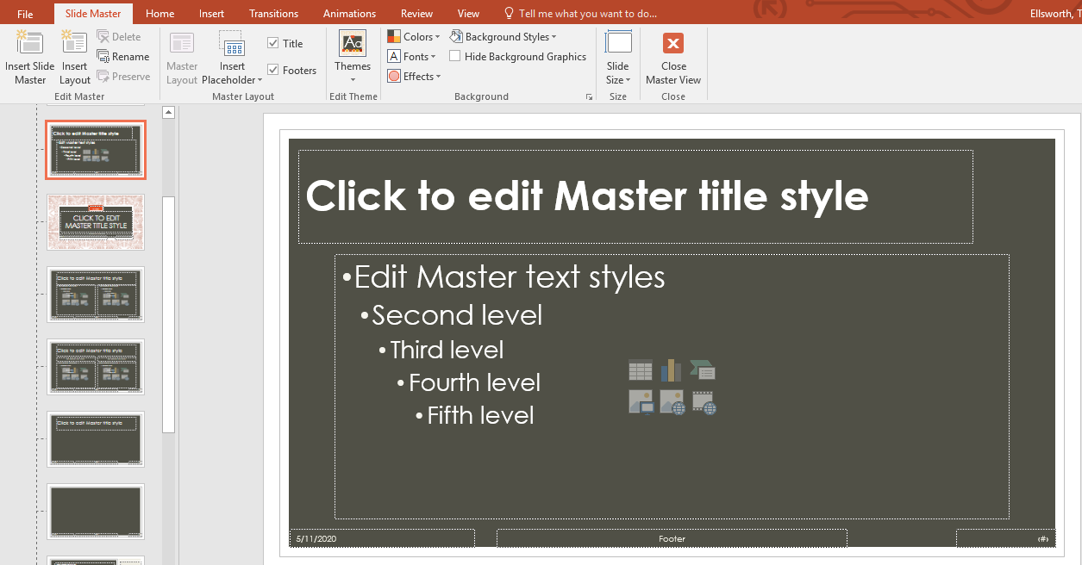
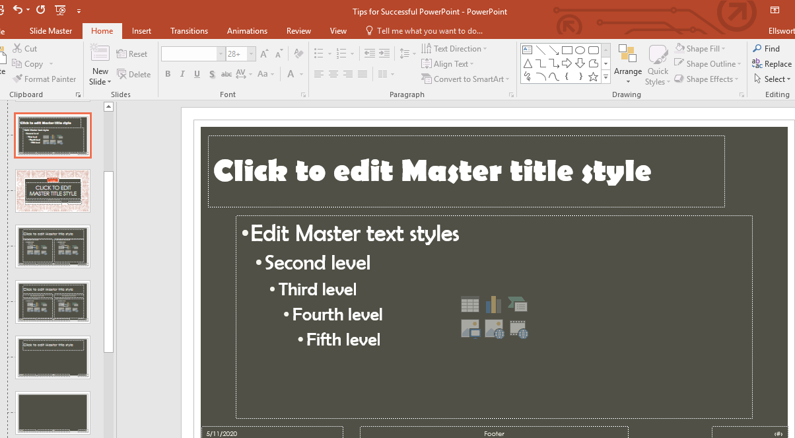
View
- Slide Master
Allows you to change the default format of each individual slide style.
  You only have to change it once on the slide master, rather than changing it on each slide.

Slide 15
Don’t forget your shortcuts
Ctrl s – save
Ctrl m – new slide
Ctrl a – selects all
Ctrl z - undo
Ctrl c - copy
Ctrl x – cut
Ctrl v – paste
Ctrl p – print
Ctrl n – new document

